Slide 1
You Grow.
We Grow.

Slide 2
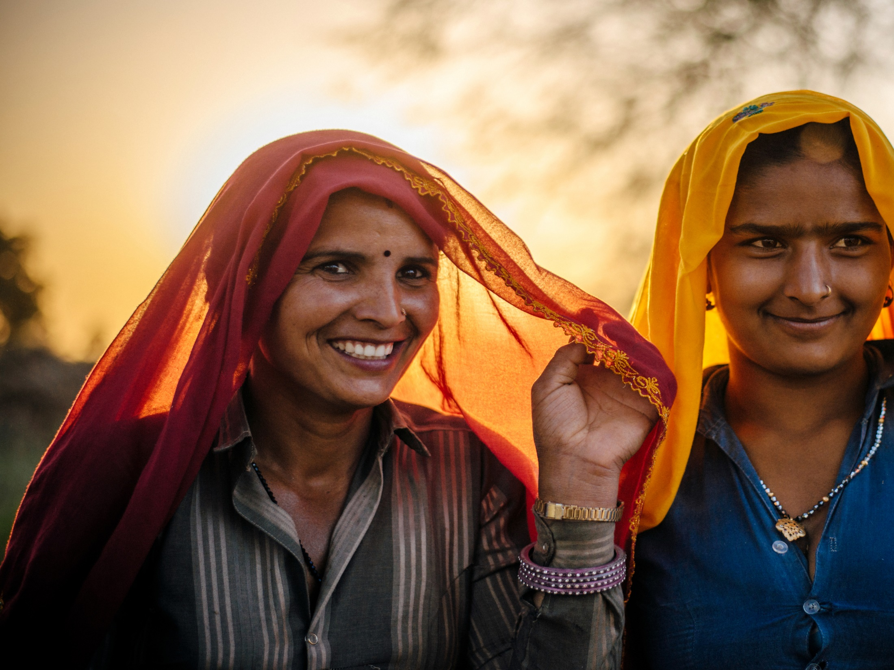

Slide 3
Our various initiatives
have yielded
significant impact in
rural communities.
We believe when
rural communities grow,
the nation grows
and so do we.
You Grow.
We Grow.

Slide 4
Introduction
Corporate Social Responsibility (CSR) in India has
evolved since the inception of the Companies' CSR Rules 2014. The project mode approach mandated
by the Companies' Act has revolutionized the way
CSR is being looked at and implemented. The focus has shifted drastically from mere philanthropic contributions to strategic/ developmental CSR. For CSR to be institutionalized, it is essential that it is supported by partnerships between government, business and non-governmental organisations.
We at L&T Financial Services (LTFS), in alignment
with the Companies' CSR Rules 2014, follow a strategic approach for all our subsidiaries towards
all CSR initiatives. Given our Pan India presence and existence of a significant Rural Finance portfolio, we have been attempting to create value for marginalized communities which deserve a secure future. Our core thematic areas of Integrated Water Resource Management (IWRM) and Digital Financial Inclusion are designed to ensure sustainable livelihood opportunities with intent to bring the deserving but vulnerable population into the mainstream economy. It is an effort to facilitate the way with which India transacts and sustains through the uncertainties.

Slide 5
Vision
We aspire for an inclusive
social transformation of the
rural communities that we
serve by nurturing and creating
opportunities for sustainable
livelihoods for them.
Mission
Our mission is to reach
marginalized farmers and
women micro-entrepreneurs
in the rural communities
that we serve and work
towards rejuvenating their
ecosystems thereby creating
sustainable livelihoods and
enabling financial inclusion.

Slide 6
Executive Statement
As a responsible corporate citizen, LTFS is committed to not only providing world-class products and services, but also creating shared value for the communities that we interact with. LTFS has an established Rural Finance portfolio wherein the business directly engages with the rural community. This rural economy is predominantly cash driven and dependent on agriculture and allied activities for livelihood.
Reinvesting in this community is important for us. We have been doing this for some time and have seen significant impact over the years. We have moved well beyond philanthropic contributions and have attained significant impact milestones in these communities as part of our corporate social responsibility.
Our CSR interventions like the Digital Financial inclusion program and Integrated Water Resource Management are efforts to bring this much deserved rural population into the mainstream economy. By aligning our programs with
the Government initiatives like Digital India and United Nations Sustainable Development Goals (SDG5 - Gender Equality, SDG 13 - Climate Change and SDG 17 - Partnerships for the Goals) we are continuously striving towards a better world.
For a better world 'the best gift that
one can give to someone is her/his time'. Our employee volunteering program 'Boondein' gives employees an opportunity to contribute their time towards the society by working on initiatives like Financial literacy education, beach cleaning etc. for a happier world. I believe and urge everyone to move beyond the concept of CSR to ISR (Individual Social Responsibility) and contribute towards a better world in her/his own capacity.

Slide 7
From the CSR desk
Community welfare, participation and ownership is at the core of all our CSR interventions.
Our CSR interventions focus on delivering sustainable solutions for the long term benefit of the community. Our core CSR programs of Integrated Water Resource Management (IWRM) and Digital Financial Inclusion have been designed in such a way that final ownership rests with the community, thus ensuring long-term sustenance.
The increase in water-levels, increase
in household incomes, increase in adoption of digital finance practices are just few indicators to measure the success of our interventions. Through these, we are attempting to create sustainable livelihood opportunities for the communities. The underlying motive is that we ensure that the community progresses with us and without us as well. Employees at LTFS play a major role when it comes to on-ground
implementation of the CSR projects.
The millennial work force is keener on contributing in a way wherein they get a chance to interact with the deserving ones and experience for themselves the happiness that they are bringing to someone's life.
“Boondein”, the employee volunteering program at LTFS is a perfect platform for employees' direct involvement with the community. It gives them an exposure to the other side of the world. This direct involvement in community welfare ensures of a work culture that is empathetically business oriented.
Happy Reading!

Slide 8
CSR Approach
Adoption of 3S framework, i.e., Social Impact, Scale and Sustainability, to implement the CSR projects, ensures that we create maximum value for the stakeholders. The 3S approach ensures that it is a win-win situation for each
and every stakeholder whether it's a direct beneficiary or the implementing agency or even the organization. The project objectives are defined in such a way, that the resulting outcomes and outputs add significant value to the stakeholders.
Alignment with Sustainable Development Goals (SDG’s)
The Sustainable Development Goals are the blueprints to achieve a better and more sustainable future for all. They address the global challenges we face, including those related to poverty, inequality, climate, environmental degradation, prosperity, peace and justice. LTFS ensures that all their projects are in alignment with the SDG’s so that they can contribute in a more sustainable manner.

Slide 9
Social Impact
The projects are identified on the basis of detailed baseline and need assessment surveys. Regular assessments and stakeholder workshops, on a regular basis, ensure that voice of the community is taken into account and project model is adequately developed with clearly defined output, outcome and impact indicators. This ground work, even before the finalization of projects, helps us to ensure that projects are carefully selected and designed to create a larger social impact.
Scale
Selection of partner organizations/implementing agencies is crucial for the success of the project. A thorough due diligence is carried out to ensure that we have partners who are domain experts and have a greater understanding of the on-ground situation. This gives us the liberty to focus on the expansion of projects and scaling it to other deserving locations with the right partners.
Sustainability
Sustainability is a major factor that is taken into consideration while planning, implementing, and monitoring the project. To ensure long term sustenance of the project, the involvement of the local community is important in bringing about local development. When people at the community participate in the decisions that affect their lives, they feel attached to the decisions and actively participate in the implementation process which increases sense of ownership of the projects. The community participation in digging and burying trench, contributing money to facilitate the implementation, carrying building materials and cleaning the project area etc. ensures that, community takes care of its livelihood opportunities for a sustainable future.

Slide 10
Jalvaibhav, the Integrated Water Resource Management program is in complete alignment with the government’s effort towards ensuring climate resilient communities. The Maharashtra droughts of 2014-15 was a clear result of climate change. This resulted in LTFS taking the lead to combat the adversity and provide some respite to the agrarian community of Maharashtra by initiating the Jalvaibhav programme.
The objective of the Jalvaibhav programme is to not only create water structures, but also to strengthen resilience and adaptive capacity to climate-related hazards amongst the community.

Slide 11
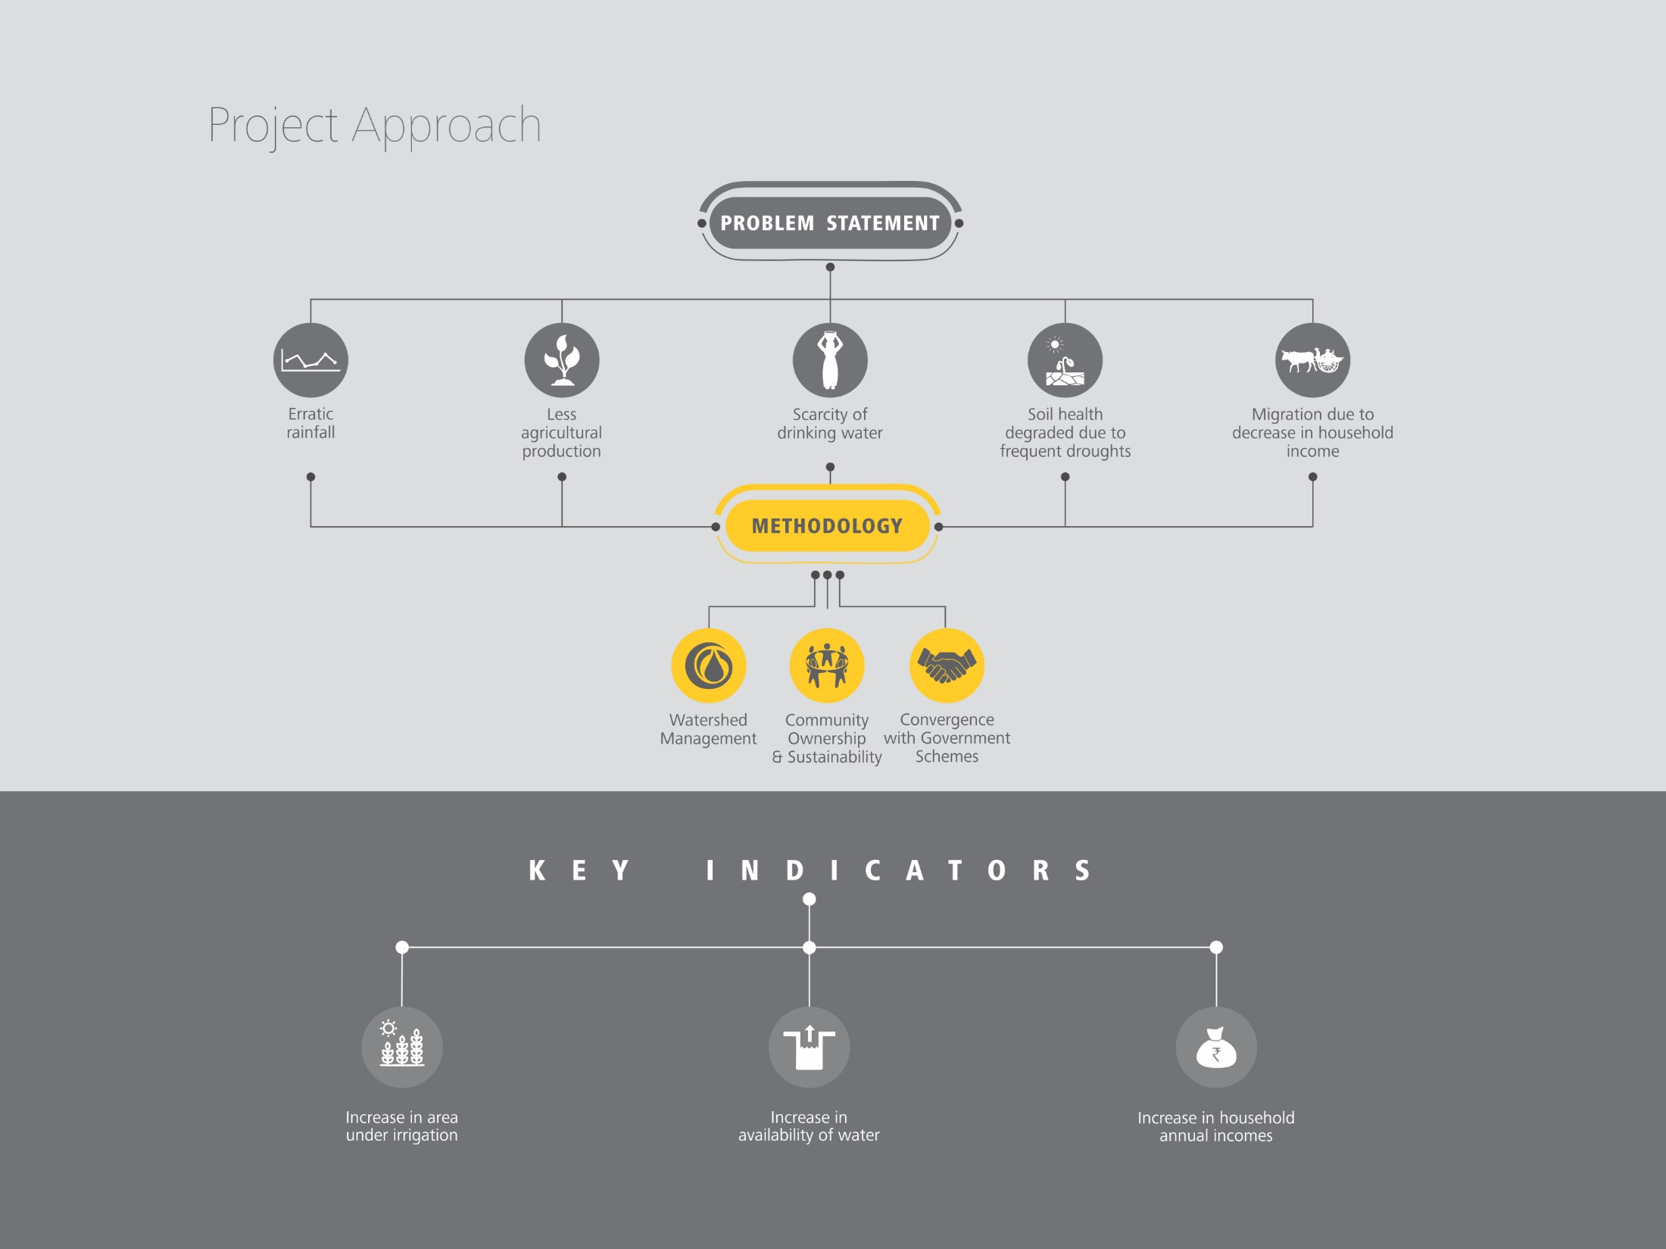

Slide 12
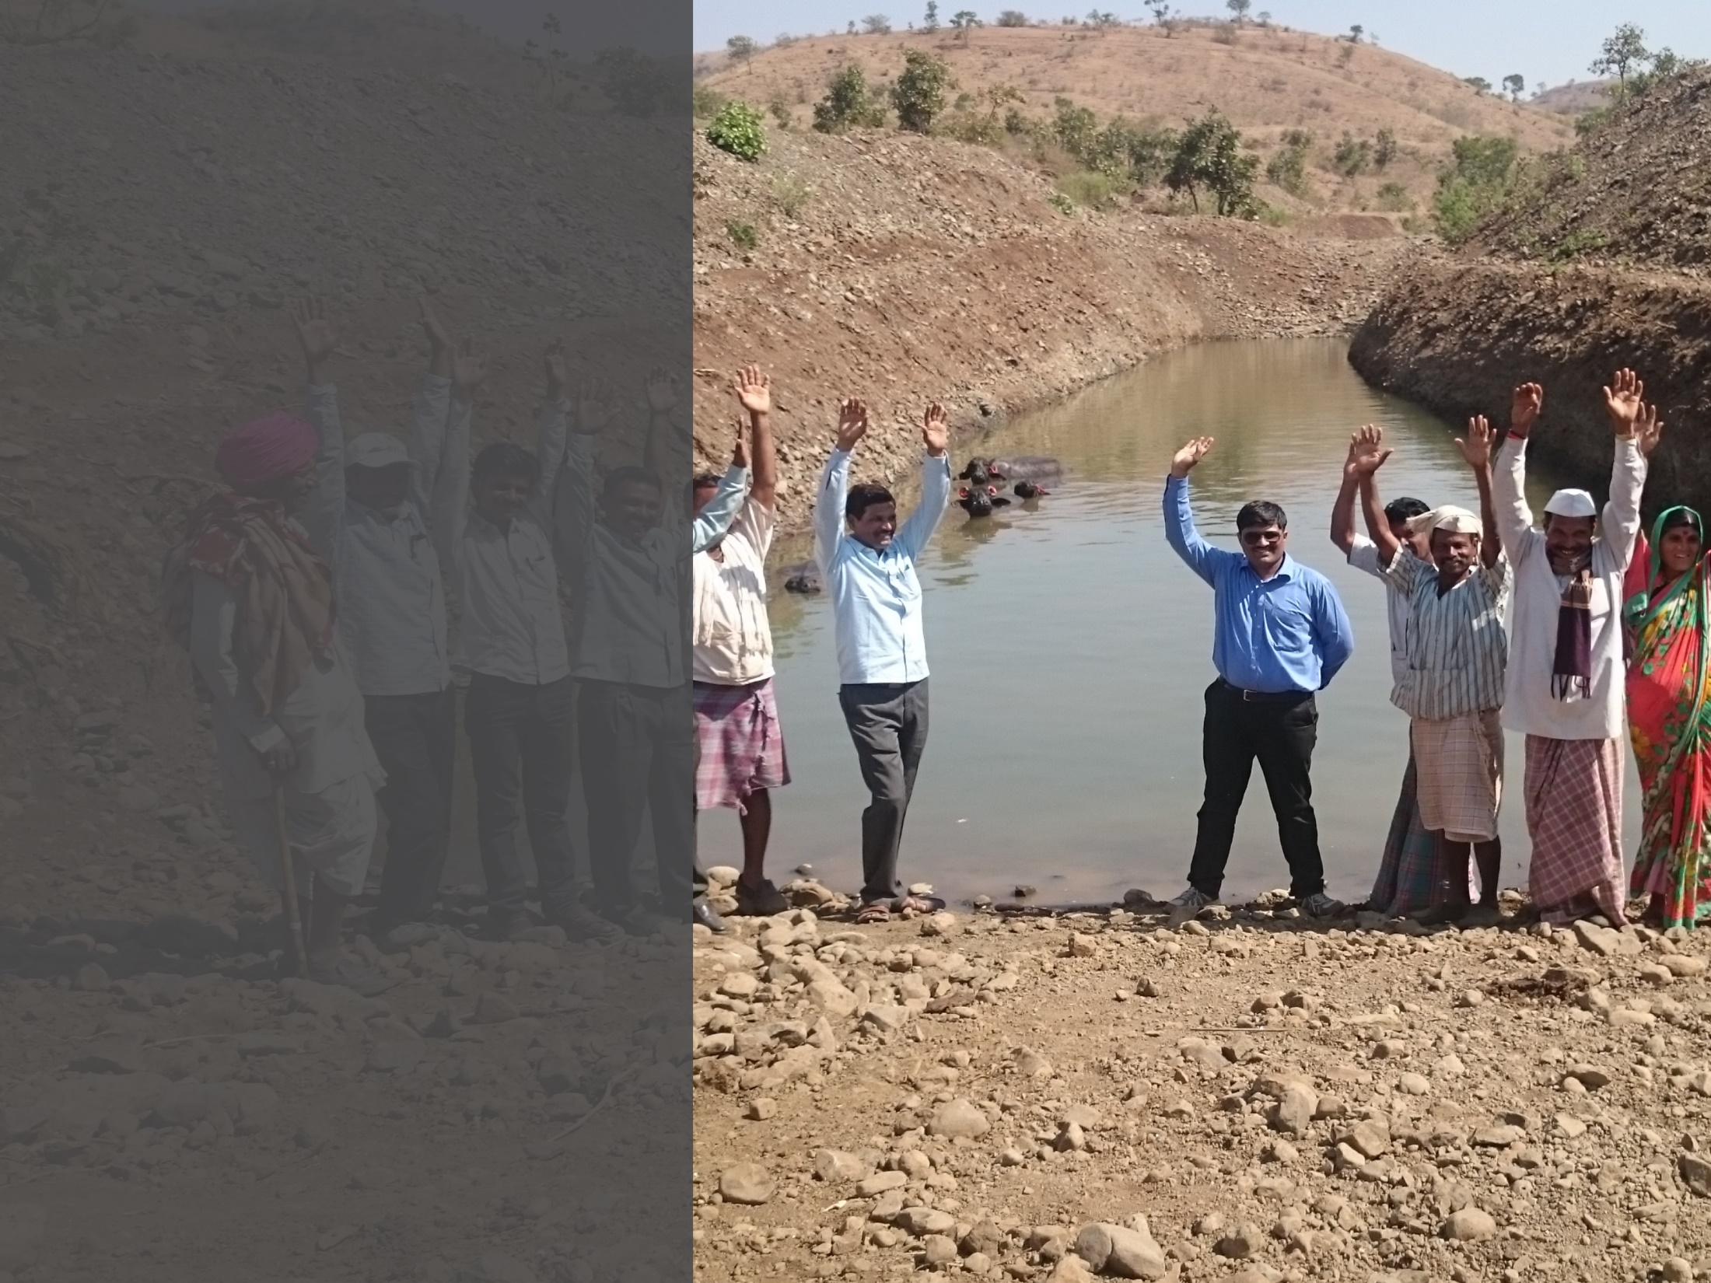
Voices from the ground
The watershed work which was completed in our village helped raise the groundwater level even though there was less rain during the year. With this increased water level, we were able to produce cash crops in the Rabbi season which would otherwise be impossible.
Radha Kishan Tonde,
Village : Seeimoha
Due to deep continuous contour trenches, work in our villages helped to recharge the ground water level with the early rains also and we could get water out for Kharip. ENB structure in our area will hold the rain for longer period and also will help for ground water recharge. With this water, we could get more water for our cotton crop this year.
Ashrub Bade
Village : Gawandhara
The works of loose boulder structures and Gabion structure done under Jalvaibhav Prakalp has benefitted me. Till last year, I was able to take rabbi crops only in
1 acre or less of my land. But this time I am able to use 1.2-2 acre of land. Our well is recharging. The works will benefit more for us in future. I am much thankful to LTFS.
Krishna L. Munde
Village : Pahadi Padgaon

Slide 13
Water Structures Created
DOHA MODEL : It is an eco-friendly and low cost water
harvesting structure built at the bed level of the stream.
It helps in harvesting rain water below ground level and
recharging groundwater tables of nearby areas. Dohas
help to reduce the soil erosion and recharge the ground
water level with less rainfall.
FARM BUNDING/COMPARTMENT BUNDING :
Farm bund or compartment bunding helps to reduce top
fertile erosion from crop land as well as water harvesting
at micro levael. Compartment bunding can help recharge
2.5 Lakh litres of water per acre over the year.
WATER ACCUMULATED PITS (WAP) : These structures
are done on small stream or brooks to conserve water with
the dimensions of 5m*3m*2m. They can hold water up to
30,000 litre at a time and can recharge up to 1.5 lakh litre
per annum (assuming that it will get filled at least
5 times in a year)
REJUVENATION OF TUBE WELLS : Repair and
rejuvenation of tube wells to effectively recharge the
water percolated through revived water bodies and
water harvesting structures.
CONTINUOUS CONTOUR TRENCHES (CCT) : Continuous
contour trenches are created on hilly areas on upper hilly tract.
These help in conservation of soil and water in upper hilly tracts.
Thus the water percolates down with aquifer and helps to increase
water levels of well in surrounding area. Excavators are deployed
for digging the contours. Distance between the contour lines is
30 meters and depth of CCT is 1 meter based on slope of hill.
EARTHEN NALA BUNDS : This is built across the
stream to stop the water and conserve the water
and store water.
LOOSE BOULDER STRUCTURES : This is a small structure
constructed in the upper ridge of watershed area or waste
land having slope more than 5%, undulating topography and
where run off is high. This intervention helps to reduce velocity
of run off and stop erosion in upper part of watershed. All of
these structures are constructed with help of local material
available at site.
DE-SILTING OF DAMS AND POURING SILT
ON THE LAND : Majority of the water bodies in and
around the villages are filled with fertile silt and this has
reduced water holding capacity also. The desilting of the
water bodies not only increases the gross water holding
capacity of the water body but also increases the fertility
quotients of the farms where the silt has been applied.
The farms where silt has been applied will show
enhancement in farm incomes at least by 3 times.
Convergence with Local,
State and National Programmes

Slide 14
The economic empowerment of women is at the heart of the 2030 UN Agenda. The Sustainable Development Goals would not be achieved if there is no accelerated action to empower women economically. Women's participation in all spheres of life, including in the economy, is essential to sustainable and durable peace and to the realization of human rights. Government schemes like Aadhaar Pay, more PoS machines, Bharat Net, would go a long way to augment the drive towards digital transformation.
To increase the uptake of digital financial services among rural women, we have to address three issues. The first is their lack of awareness and access to digital technology; the second is conservative mindset and existing social and cultural norms in households and communities; and the third, of course, is the lack of infrastructure.
Believing that women, when empowered with skills can become efficient change agents in their community, the 'Digital Sakhi' programme was co-created by LTFS along with its implementing partners.
Digital Sakhi - The Digital Financial Inclusion programme believes in bringing the know-how of Digital modes of transactions to rural India. A Digital Sakhi is a rural woman with a digital device in hand, equipped with skills and knowledge to confidently impart digital financial literacy training to women, particularly entrepreneurs in her villages.
The 'Digital Sakhi' programme has another leg as a part of which women entrepreneurs practicing goat rearing, poultry, dairy and tailoring are chosen and up-skilled in their respective trades to yield better produce.

Slide 16
I have been managing a general store along with my husband before enrolling as a Digital Sakhi. Inner transformation through the foundation training enabled me to impart financial literacy with ease among the community. The expertise and confidence that was gained as a Digital Sakhi has enabled me to spread digital financial literacy.
Mrs. Sunita Taware
Village Warvand Cluster : Daund
I come from an extremely conservative family that did not believe women can step out of their homes and make a contribution to society. This training got my keen interest and attention from the first moment that I heard about it. I imbibed all the trainings on digital financial literacy skills enhancement and EDP. My family members have seen the positive change in me and have become very supportive and encouraging. I enjoy spreading awareness about digital literacy and it gives me tremendous peace of mind and happiness.
Mrs. Laxmi Patil
Village Bembali Cluster : Osmanabad

Slide 18
Disasters, natural or man-made are increasing day by day and we as part of the community cannot remain isolated from its effect. Relief and Rehabilitation is an important component of LTFS's CSR policy.
We at times of necessities have contributed to the Prime Minister's relief fund. Also, our employees have gone a step further by being involved directly in relief perations.
Recently, Kerala suffered from one of the most frightful floods in its history and our employees tirelessly involved themselves to ensure that relief packets were provided to the affected people.

Slide 19
‘Little drops of water make a mighty ocean', with this thought, “Boondein”, the employee volunteering program was conceptualised in January 2017. LTFS values, respects and attends to the individual’s desire of support.
Through the programme “Boondein”, employees volunteer with their heart and soul in projects and programmes, specially designed themes of water-wise and
money-wise to carefully bring changes in the community.
The impact is both ways - as the community gets facilitated with the skills imparted, employees start to care more for the lesser privileged individuals whereby developing a caring culture in the organisation. Employees take pride and display excellence with the confidence that they contribute to a sensitive and compassionate corporate house.

Slide 21
Partners Speak...
The NGOs’ Capacity Building program is designed to support NGOs, develop effective and well-managed organizations that make best use of their human and financial resources to maintain business sustainability. With great focus on delivering successful strategies, emerging tools, specific skills and tactics necessary to build the capacity of NGOs, the program aims at empowering the organizations to perform better internally and towards the community they serve.
With the intent to offer a highly specialized training program, LTFS, in collaboration with KPMG, conducted the Social Return on Investment (SRoI) training in August 2018 for all its implementing partners. This training will help the partner organisations to measure the total value generated for every rupee invested in development sector interventions.
The workshop was very informative and valuable. The interactive nature of the programme ensured equal participation by all. The Social Return on Investment (SRoI) training helped us to look at our project from a different lens. It has improved our efficiency towards delivering impact. We thank LTFS for the opportunity.
K Senthilkumar - Project Director
Digital Sakhi Tamil Nadu
Sri Aurobindo Society, Pondicheerry
Convergence was a great platform created by LTFS through which all CSR implementing partners came together. The training on Social Return on Investment (SRoI) conducted by LTFS was very fruitful in finding gaps in monitoring our existing projects. We have started calculating our project impact using the SRoI methodology already.
Vaishalee Khadilkar - Project Manager
Jalvaibhav
Dilasa Janvikas Pratishthan

Slide 22
Every year, thousands of lives are lost on the roads nationwide, and every year, road safety becomes more and more important to teach our children as they become the future responsible citizens of the country.
In an attempt to have a generation that is more aware and follows road safety diligently, LTFS along with its implementing partners is spreading awareness on road safety amongst school going children and community members. In addition to this, LTFS has also partnered with Mumbai Traffic Police to support and strengthen the existing road traffic management and facilitate seamless traffic control. Also, to ensure a sustainable livelihood opportunity, youth traffic wardens are being supported by LTFS.
CSR Support
Material support
Livelihood support to
youth traffic wardens

